Slide 1
A Data Driven Approach for making investment decisions using Peer to Peer Lending Platforms
Foundations of Data Science
William Caisido
Mentor: Vishal Ratra

Slide 2
Overview
Motivation
Objective
Domain Knowledge
Data Set & Approach
Exploratory Data Analysis
Visually Modeling Data Relationships
Results & Discussion

Slide 3

Motivation
Lending Club is the largest P2P Lending Company in the world (Over 15 $Billion in loans originated)
Borrowers can request loans, which can be funded by anyone who wants to invest
But how do you know which loans to choose?
What are the factors we need to pay attention to when investing if we want to generate a return and avoid any losses?

Slide 4
Objective
The goal of this project is to:
Extract understandable patterns and associations from data through machine learning and data visualisation.
Recommend a secure strategy for choosing which loans to invest in based off the data

Slide 5
Domain Knowledge
High Risk Borrowers have higher Interest Rates, which means they may have trouble paying heir loans back, but you make more money investing in their loans.
Low Risk Borrowers have lower interest rates because their behaviors suggest they have a much higher chance of paying their loans back. You make less money off of them, but have a higher chance of getting a return than High Risk Borrowers
The worst thing that can happen is a customer fails to pay back their loan (it is charged off) You do not recover any of the money you provided to fund their loan.
The ideal loan is one that has an interest rate high enough for us to make good money, but also has a high chance of being paid back
To invest smartly we need to figure out which attributes are highly correlated customers charging off / paying their loans in full and invest with those in mind.

Slide 6
Data Set & Approach
Lending Club’s Data Set, Years 2012 - 2017
Available from Lending Club’s Website
https://www.lendingclub.com/info/download-data.action
Raw Data - 145 Variables / 1,722,935 Observations
Cleaned Data – 32 Variables / 721,719 Observations
Use glm() function to inspect correlational relatioships
Use stepAIC() Function to extract only variables that are signifigantly correlated to loan status “Charged Off”
Use ggplot2() to visualize data and understand what the relationships are

Slide 7
Exploratory Data Analysis
The following 15 variables were determined to be indicators of charge offs:
Term Length
Grade
Loan Amount
Interest Rate
Annual Income
Debt to Income Ratio (DTI)
Delinquents in the last 2 years
Revolving Credit Utilization
Total Accounts Open
Total Current Balances
Accounts Opened in the last 24 Months
Mortgage Accounts
Accounts Ever 120 Days Past Due
Number of Active Trade lines
Tax Liens

Slide 8
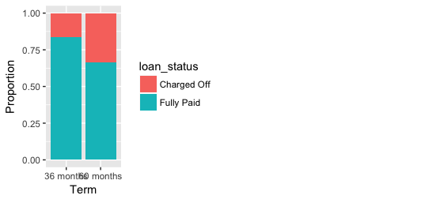
Graph of Loan Status Vs. Term:
We can clearly see that loans with shorter terms get paid back at a much higher rate.
Those with longer terms have a much higher rate of being charged off

Slide 9
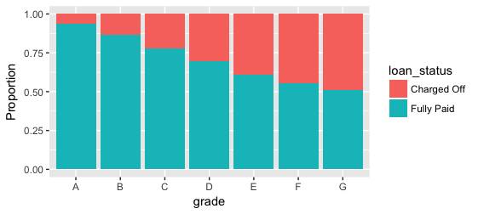
Graph of Loan Status Vs. Grade:
There is a very clearly linear relationship
Between Grade and status. The lower the
Grade, the higher the change a customer
Will not pay their loan back

Slide 10
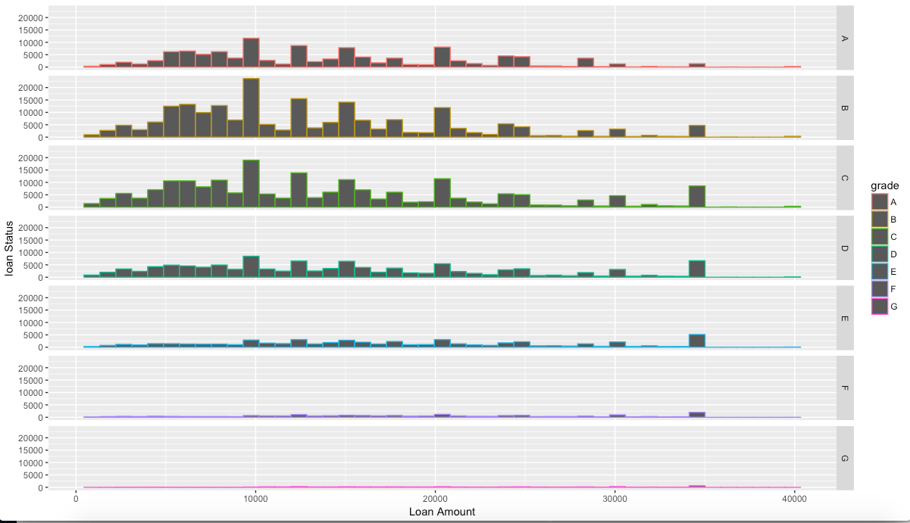
Graph of Loan Amount Vs. Loan Status divided by Grades:
We can see that the highest
Amounts borrowed and paid
back are around grades B & C

Slide 11
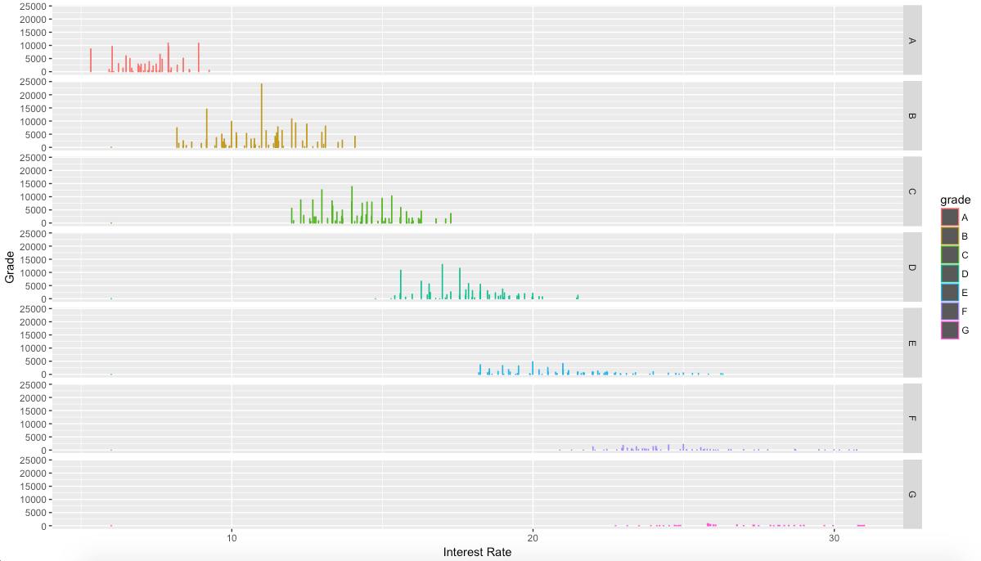
Graph of Interest Rate divided by Grade:
We can see from this graph that
The lowest interest rate a loan with
Grade C gets is 18%. We wouldn’t
Want to invest in loans with grades
below ‘C’, so 18% is the maximum
Interest rate we’d allow on a loan
we’d invest in

Slide 12
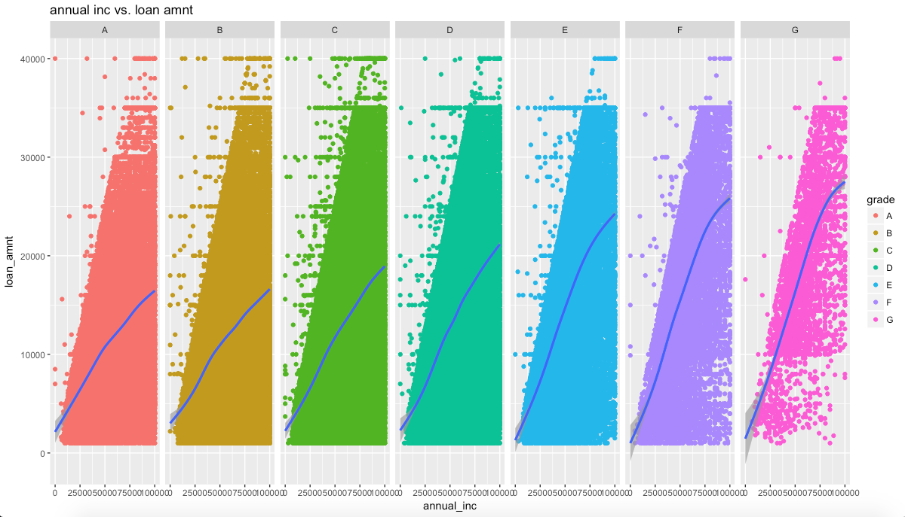
Graph of Annual Income Vs. Funded Loan Amount:
From this graph we can see
That the sweet spot of loans we want to invest in are loans from 15k- 28k.
We can also see that the
Minimum annual income we’d want to accept is around 50K

Slide 13
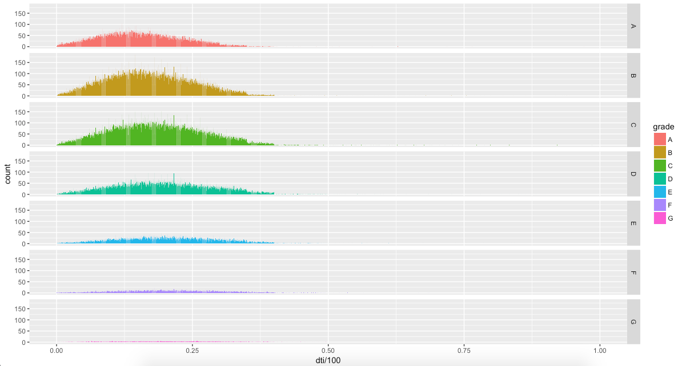
Graph of DTI divided by Grade:
We can see from the graph
that Grades A,B & C have
the most credit depth and
Thus are loans we want to
Invest in. We do not want to
touch any loans with a grade
lower than ’C’

Slide 14
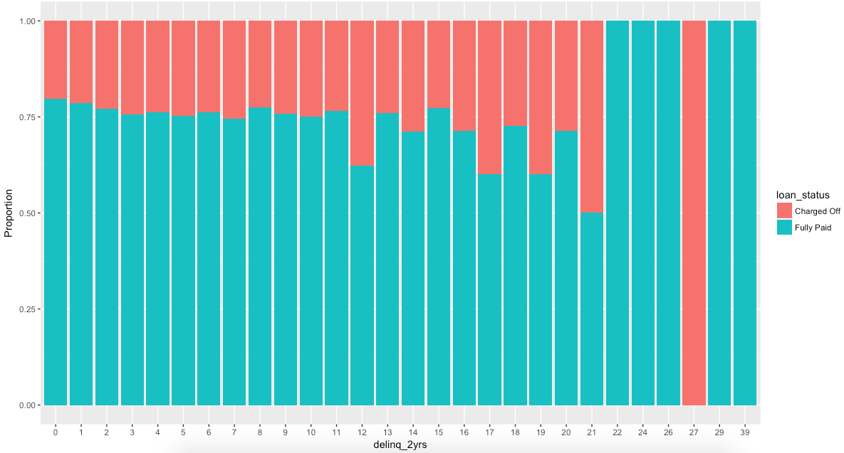
Graph of customer Delinquents on Accounts within the Last 2 Years:
There are a few issues
with some of the data
points, but over all
there’s a definite trend.
We don’t want to invest
in ANY loans that have
even 1 delinquent on
them.
We can see from the
graph that loans with
even only 1 delinquent
only have an 80%
probability of being paid
back

Slide 15
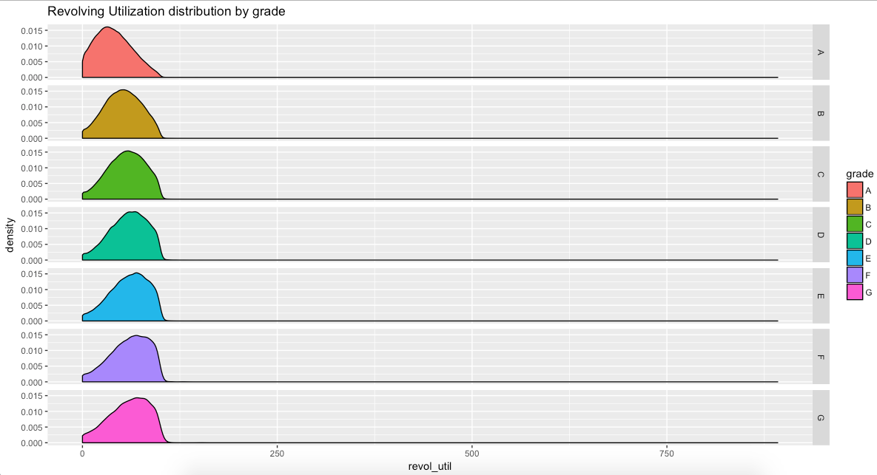
Graph of Revolving Credit Utilization divided by Grade:
This one is very interesting.
We see that even up to 30%
Utilization can still have an
‘A’ Grade.
We want to avoid
loans where the Utilization
Is over 50%

Slide 16
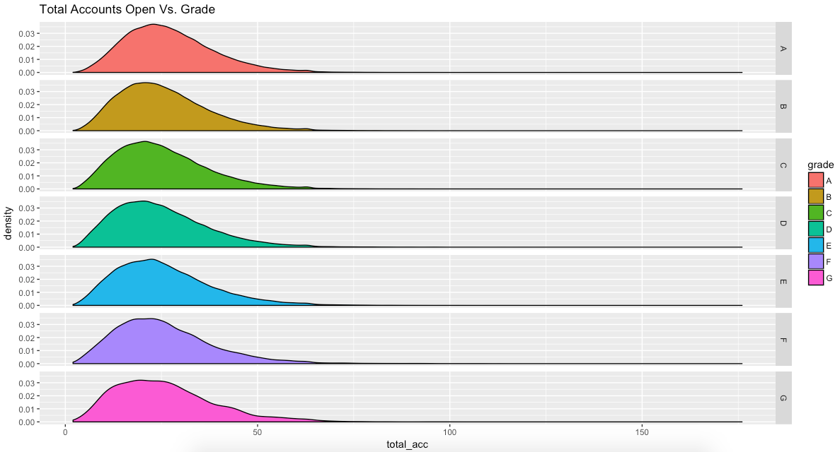
Graph of Total Accounts Open divided by Grade:
From this graph, we can
see that this isn’t the factor
with the highest impact,
but it looks like more is
better when it comes to
Accounts Open

Slide 17
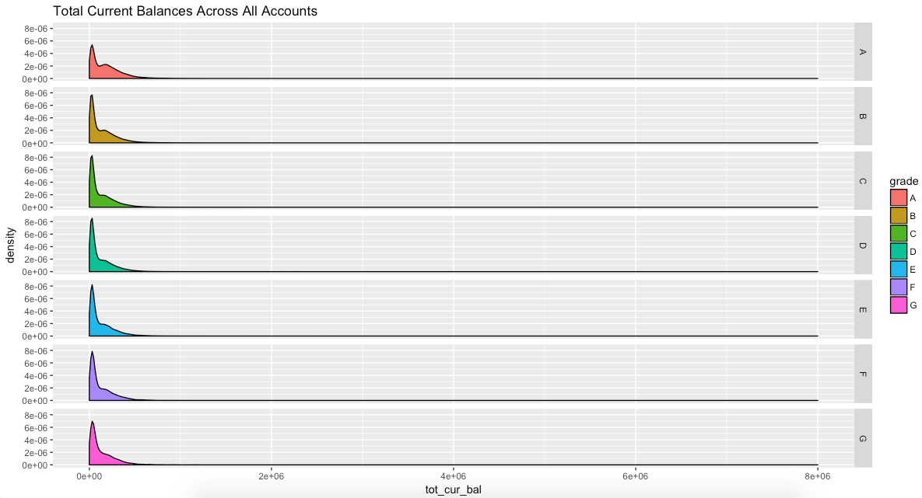
Graph of Total Current Balances divided by Grade:
This one is harder to make
sense of, but it looks like
you want total current
balances across all credit
accounts to be lower
(which makes sense)

Slide 18
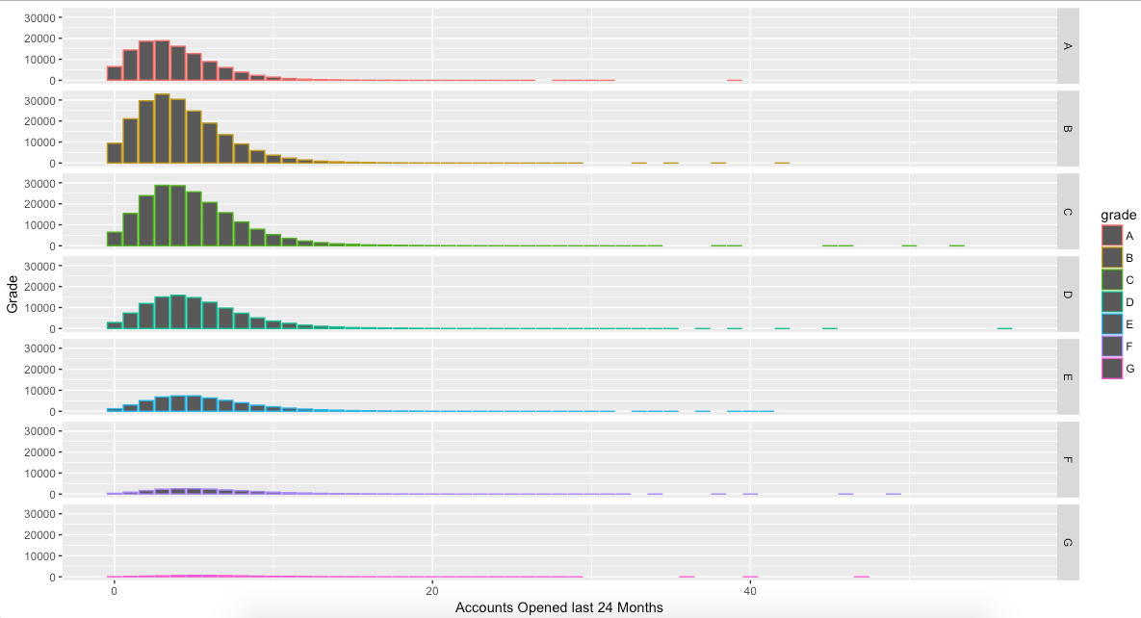
Graph of Accounts Opened by Customer in the
Last 24 Months divided by Grade:
We can see from the graph
that Grades B & C are
opening the most accounts,
probably because they are
building their credit.
Grade A have slowed down
on opening new credit
accounts, probably
because they don’t need to
anymore

Slide 19
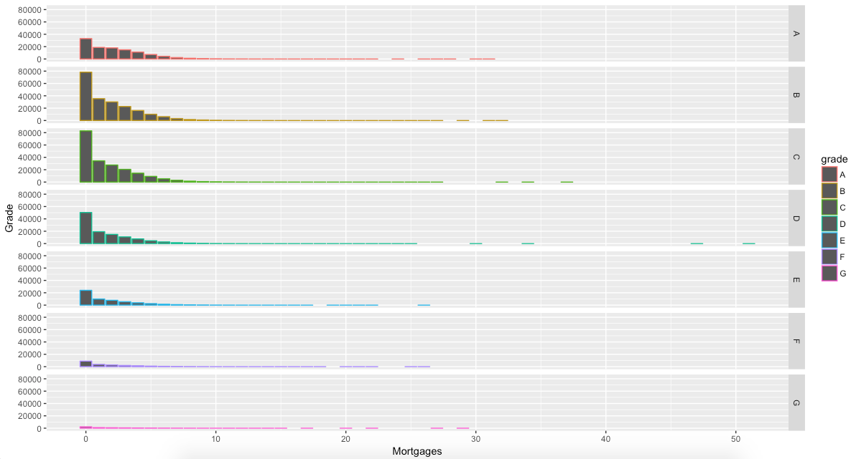
Graph of Mortgage accounts by Grade:
We see that the majority of
accounts with mortgages
get graded as B & C.
Most likely because when
you take out a mortgage
it immediately increases
your DTI and thus drops
your credit score

Slide 20
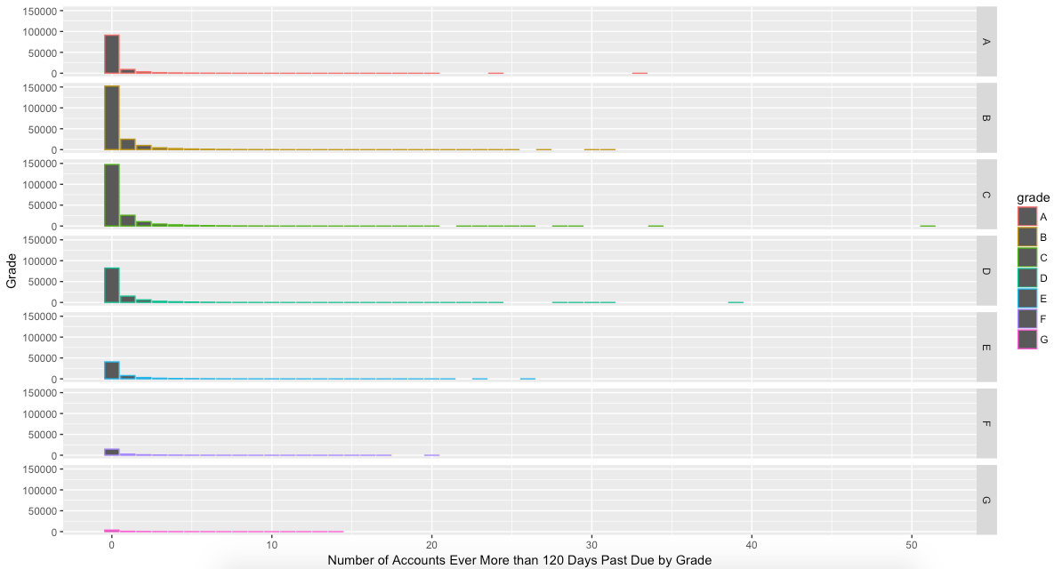
Graph of Number of Accounts Ever Gone More than
120 Days Past Due Divided by Grade:
This is a very confusing
distribution. Could be
because most people have
average credit and may
have 1 or 2 times they’ve
gone past due more than
120 days.
There may also be limited
data points in the data set.

Slide 21
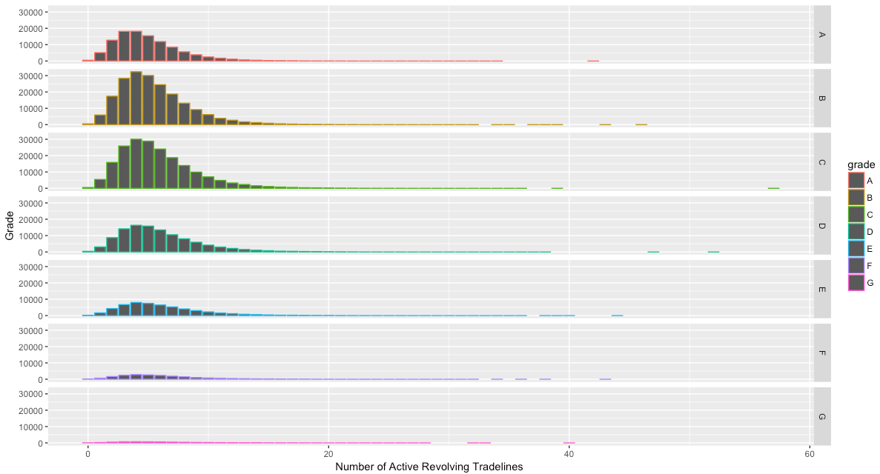
Much like the graph of Accounts
Opened in the last 24 Months, it
looks like Grade A customers
have enough credit lines open.
Grades B & C might have more
open since they’re trying to
build credit or are actively paying
on cars and homes. Grade A
customers may have paid those
loans off and closed them
Graph of Number of Active Revolving Tradelines:

Slide 22
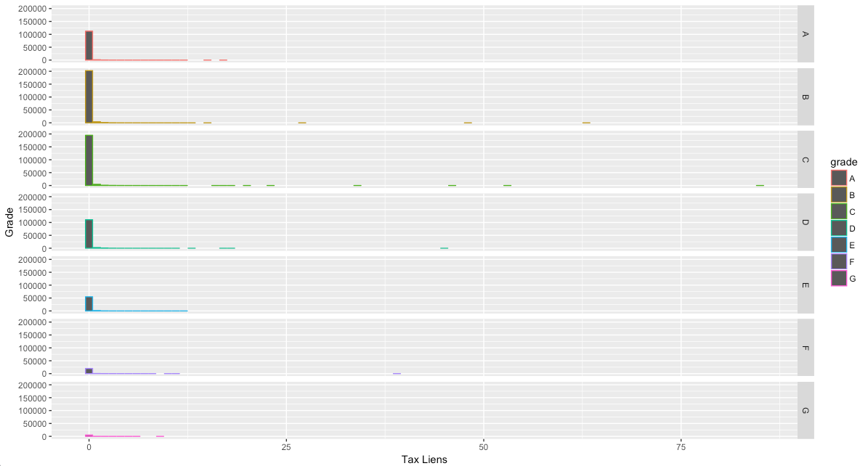
Graph of Customer’s Tax Liens divided by Grade:
Once again, it looks
like we might just not
have enough data
points in the set to
make accurate
predictions.

Slide 23
What to Look For:
Terms: 36 Months
Grades: A,B & C
Loan Amounts: Under 25k
Interest Rate: Anything under 18%
Annual Income: Over ~50k (Especially relative to loan amount)
DTI/Revolving Credit Utilized: in the 10%-50% Range (~30% is the sweet spot)
Delinquents: 0
Accounts Open/ in the last 24 months: More is better!

Slide 24
What to Avoid:
Terms: longer than 36 Months
Grades: D,E,F,G
Loan Amounts: in the higher end (anything really over 30k)
Interest rate: Anything over 18%
Annual Income: under ~50K (Especially when combined with higher loan amounts)
DTI/Revolving Credit Utilized: under 10% or over 50%
Delinquents in the past 2 years: ANY loans where the customer had delinquents
Accounts Open/in the last 24 Months: Low to zero. You want to see them growing their credit

Slide 25
Future Work
Create a customizable dashboard that tracks all of the variables in each loan
Create a predictive model that will beat native accuracy
We can also create an automated program (or AI even) that will pick loans for us automatically based off of the criteria we set.

